Slide 1
Linear Regression
Adapted from Andrew Ng’s Course on Machine learning

Slide 2
Several types of learning algorithms
Supervised learning
Teach the computer how to do something, then let it use it;s new found knowledge to do it
Unsupervised learning
Let the computer learn how to do something, and use this to determine structure and patterns in data
Reinforcement learning
Recommender systems

Slide 3
Supervised learning
Starting with an example
How do we predict housing prices
Collect data regarding housing prices and how they relate to size in feet
Example problem: "Given this data, a friend has a house 750 square feet - how much can they be expected to get?"

Slide 4
So we know actual prices for houses
The idea is we can learn what makes the price a certain value from the training data
The algorithm should then produce more right answers based on new training data where we don't know the price already i.e. predict the price
We also call this a regression problem
Predict continuous valued output (price)
No real discrete delineation

Slide 5
Can we define breast cancer as malignant or benign based on tumor size

Slide 6
Can you estimate prognosis based on tumor size?
This is an example of a classification problem
Classify data into one of two discrete classes - no in between, either malignant or not
In classification problems, can have a discrete number of possible values for the output
e.g. maybe have four values
0 - benign
1 - type 1
2 - type 2
3 - type 4

Slide 7
Linear Regression
Housing price data example used earlier
Supervised learning regression problem
What do we start with?
Training set (this is your data set)
Notation (used throughout the course)
m = number of training examples
x's = input variables / features
y's = output variable "target" variables
(x,y) - single training example
(x^{i}, y^{j}) - specific example (i^{th} training example)
i is an index to training set

Slide 8
With our training set defined - how do we used it?
Take training set
Pass into a learning algorithm
Algorithm outputs a function (denoted h ) (h = hypothesis)
This function takes an input (e.g. size of new house)
Tries to output the estimated value of Y
What does this mean?
Means Y is a linear function of x!
θi are parameters
This kind of function is a linear regression with one variable
Also called univariate linear regression

Slide 9
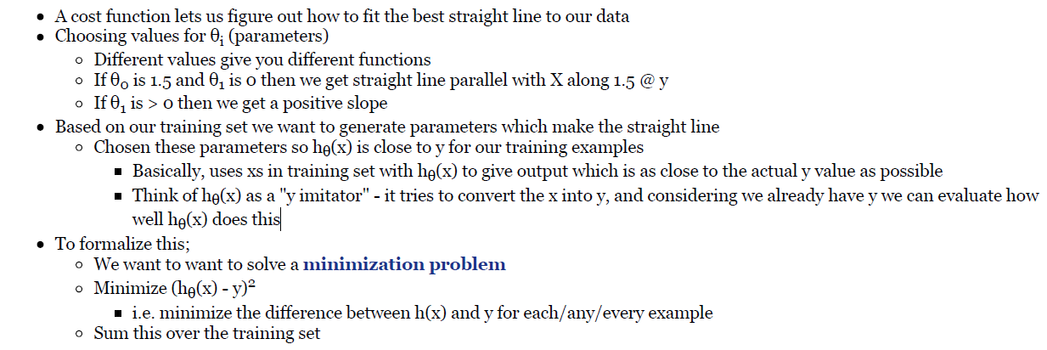
Linear regression - implementation (cost function)

Slide 10
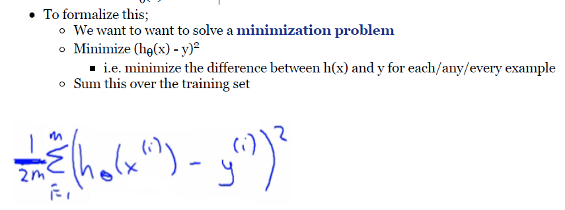

Slide 11
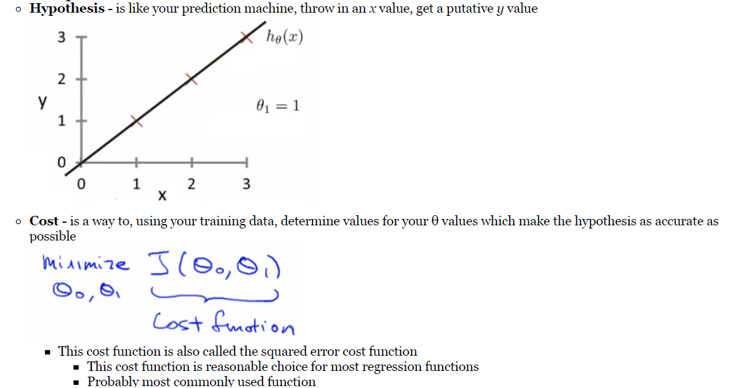
Recap

Slide 12
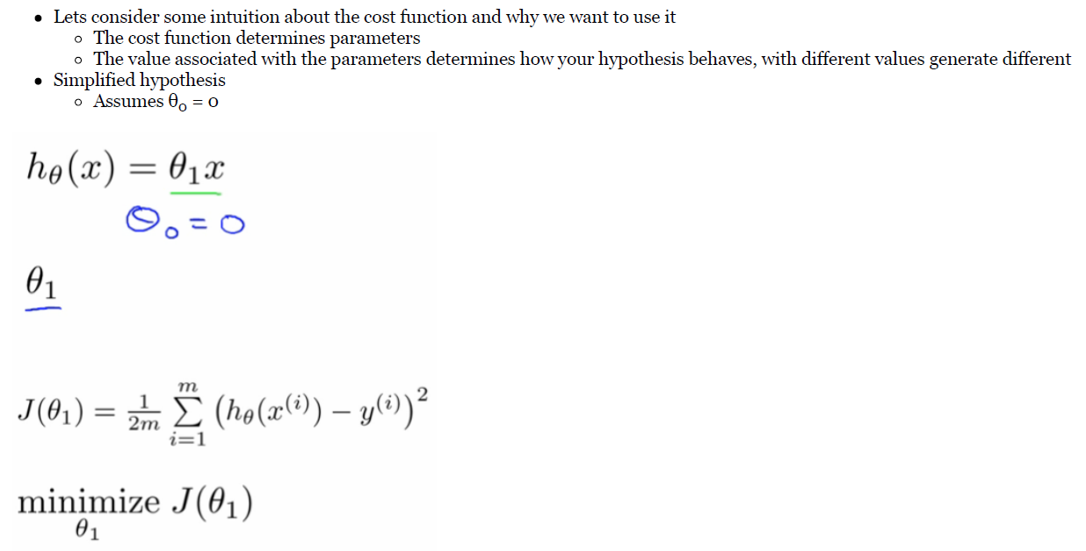

Slide 13
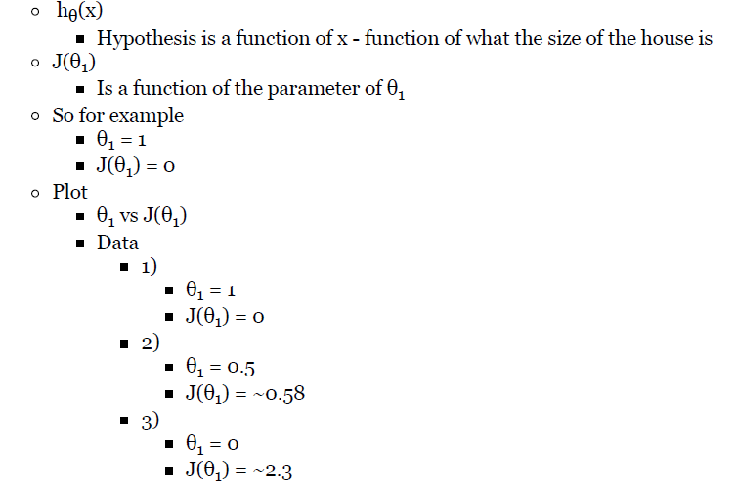

Slide 14
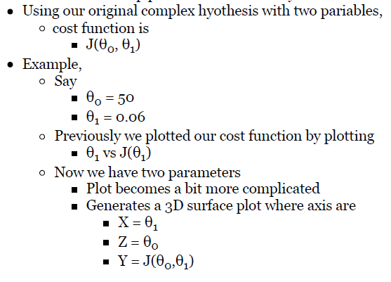

Slide 15
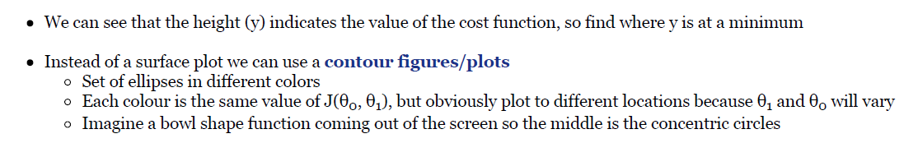

Slide 16
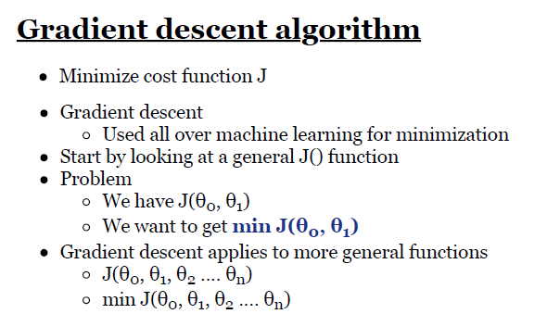

Slide 17
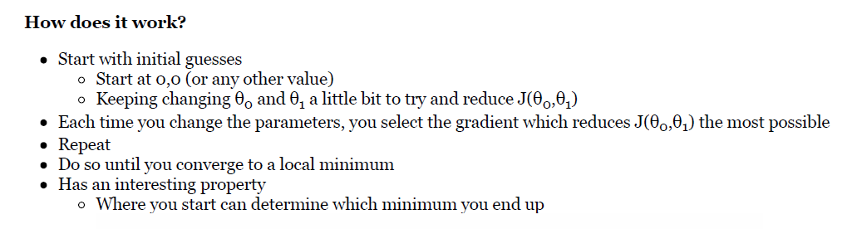

Slide 18
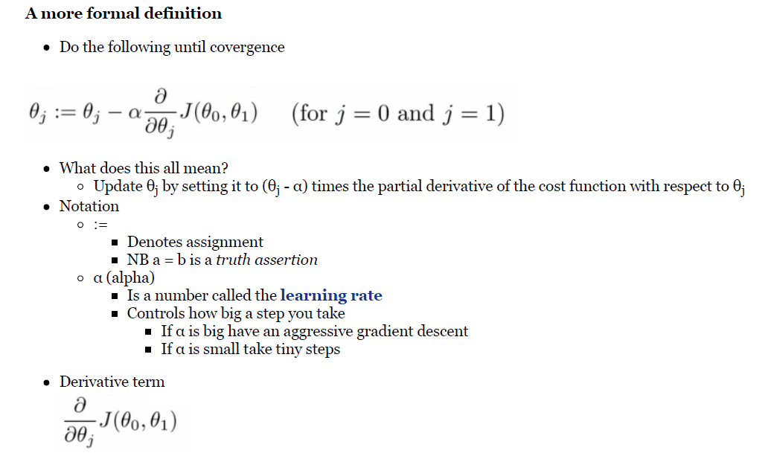

Slide 19
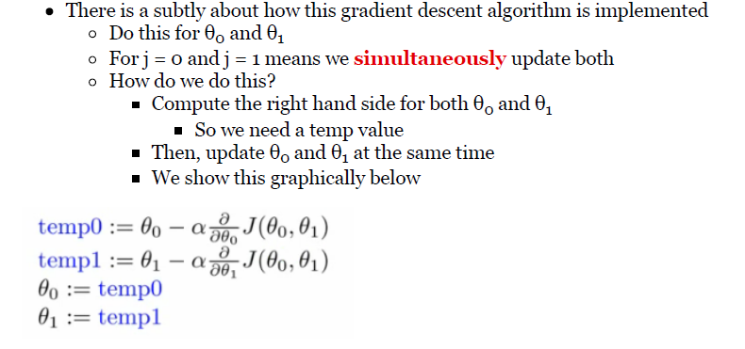

Slide 20
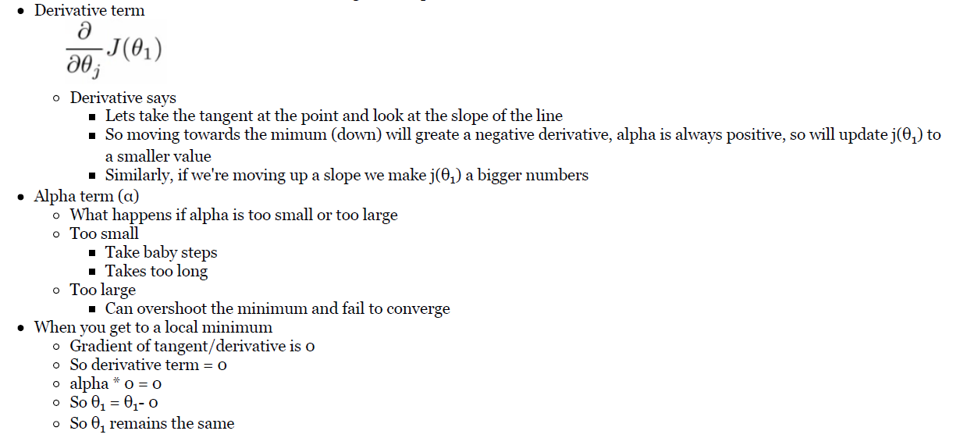

Slide 21
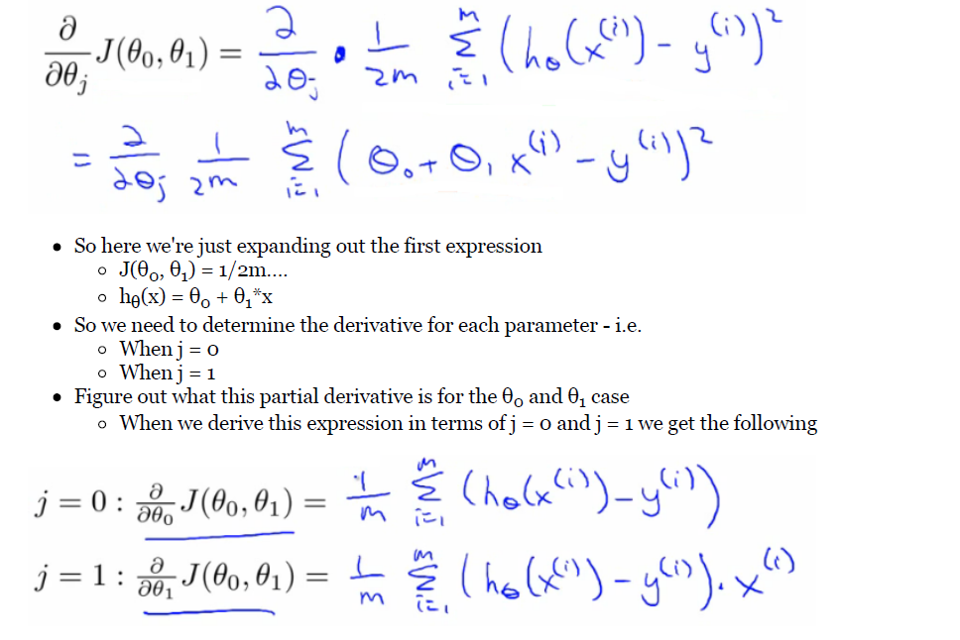
Linear regression with gradient descent

Slide 22
How does it work
Risk of meeting different local optimum
The linear regression cost function is always a convex function - always has a single minimum
Bowl shaped
One global optima
So gradient descent will always converge to global optima

Slide 23
Extending beyond least squares
Adding in modeling assumptions about the errors
Evaluation Metrics
Adding more predictors

